Slide 1

Islamic University of Technology
Course no: Phy 4143
Course Title: Physics II
Course Teacher : Dr Md. Sahab Uddin
Professor

Slide 2
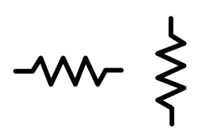

Problems to solve the circuit given below
4 Ω
5 Ω
A
B
2 Ω
3 Ω
5 Ω

Slide 3
Y - Δ and Δ – Y Transformations
Objectives
• A part of a larger circuit that is configured with three terminal network Y (or Δ) to convert into an equivalent Δ (or Y) through transformations.
• Application of these transformations will be studied by solving resistive circuits.
Δ
Y
Y
Δ

Slide 4
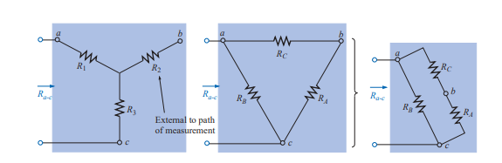
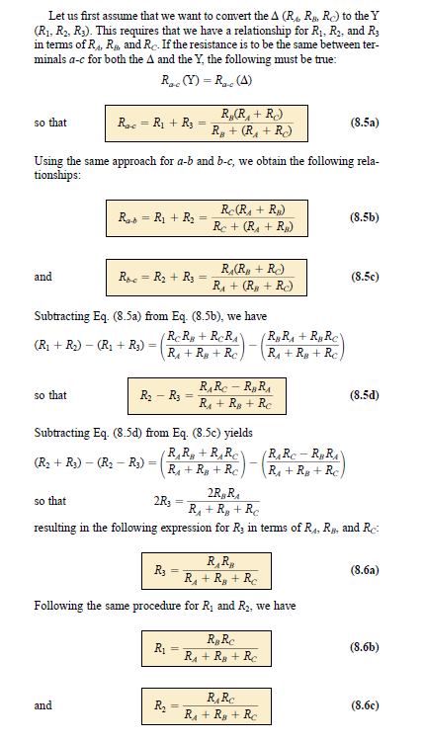
Δ – Y Transformations

Slide 5
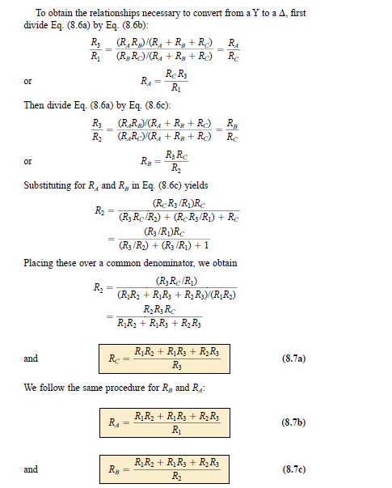
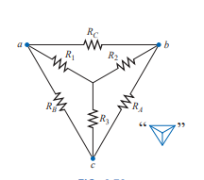
Y - Δ Transformations

Slide 6
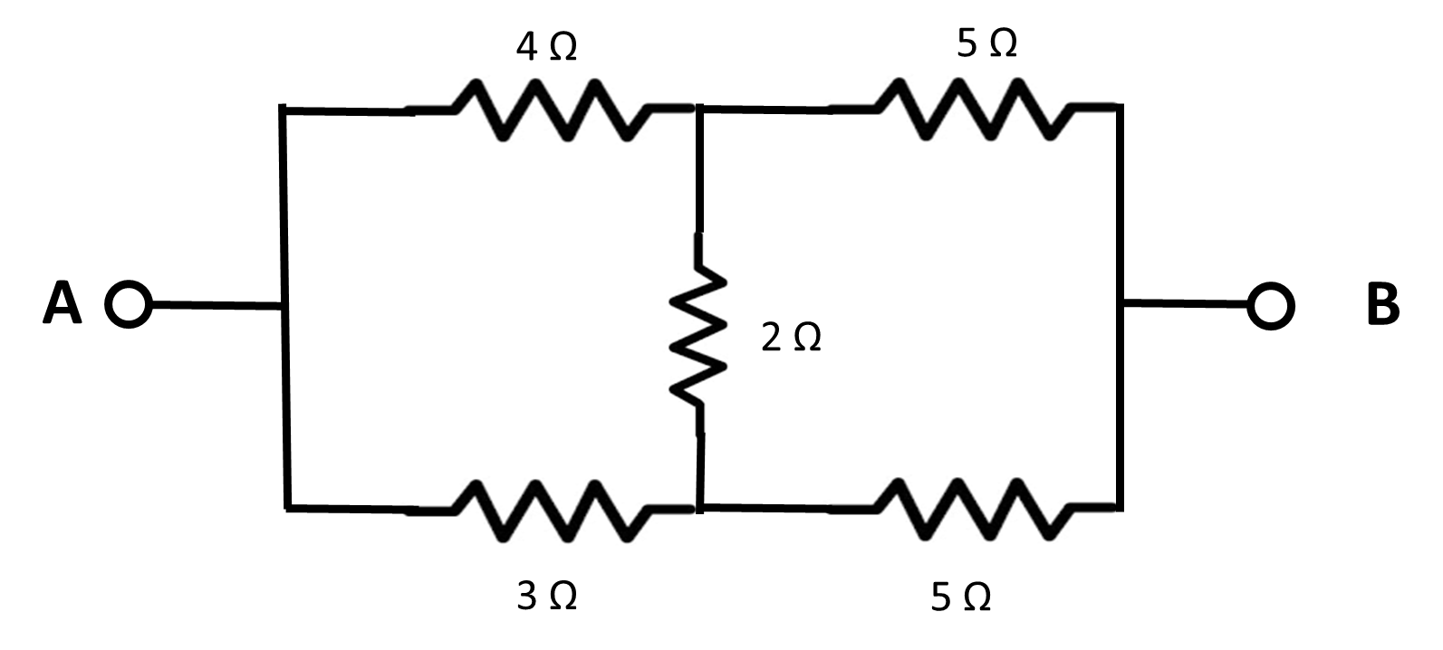
Now Solve

Slide 7
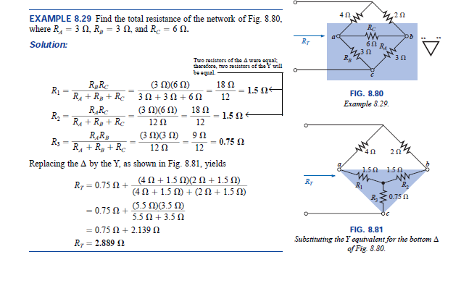

Slide 8
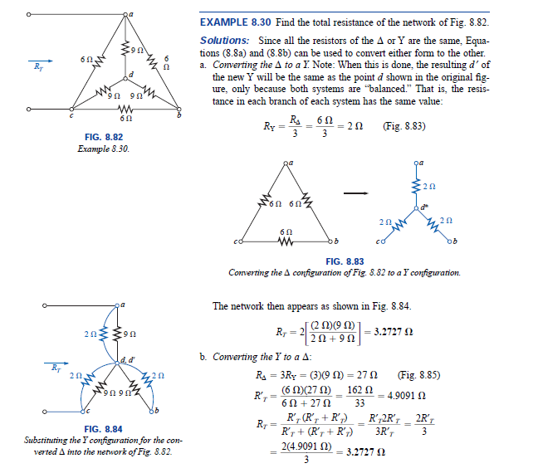

Slide 9
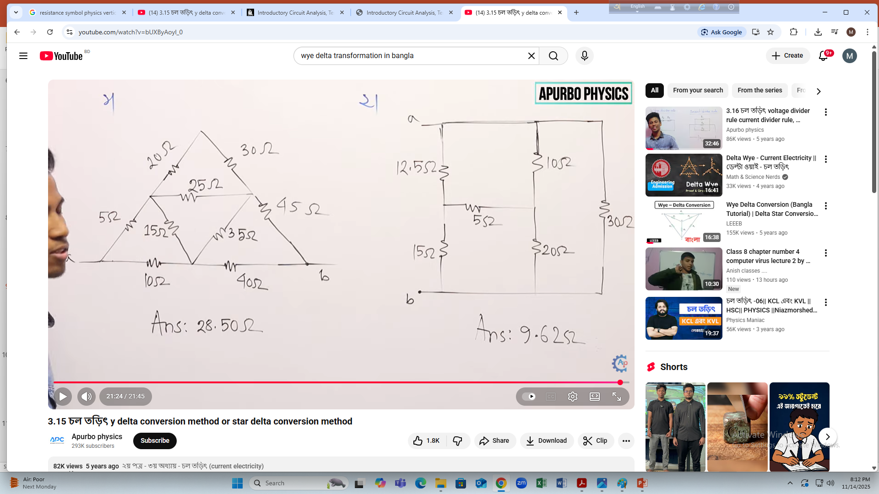
Now Solve

